Slide 1

Social Science Research Design and Statistics, 2/e
Alfred P. Rovai, Jason D. Baker, and Michael K. Ponton
Chi-Square Goodness-of-Fit Test
PowerPoint Prepared by
Alfred P. Rovai
IBM® SPSS® Screen Prints Courtesy of International Business Machines Corporation,
© International Business Machines Corporation.

Slide 2
Uses of the Chi-Square Goodness-of-Fit Test
The the chi-square goodness-of-fit test (also known as the one-sample chi-square test) is a nonparametric test specifically designed for discrete distributions. It is an alternative to the Kolmogorov-Smirnov test or Shapiro-Wilk test when discrete distributions, such as the binomial and the Poisson, are used.
It tests the hypothesis that a sample of data for one categorical variable with k categories comes from a population with a specific distribution (i.e., pattern).
  Observed frequencies for each category are compared to expected frequencies computed based upon the tested distribution.
  If there are only two categories, one should consider using the binomial test.
The test can be applied to continuous distributions only by binning them, that is, transforming them into discrete distributions.

Slide 3
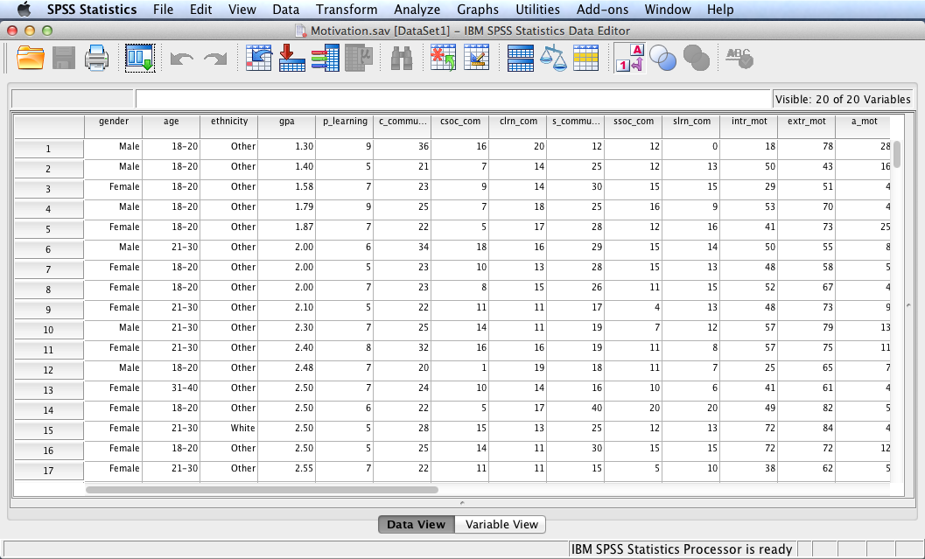
Open the dataset Motivation.sav.
File available at http://www.watertreepress.com/stats

Slide 4
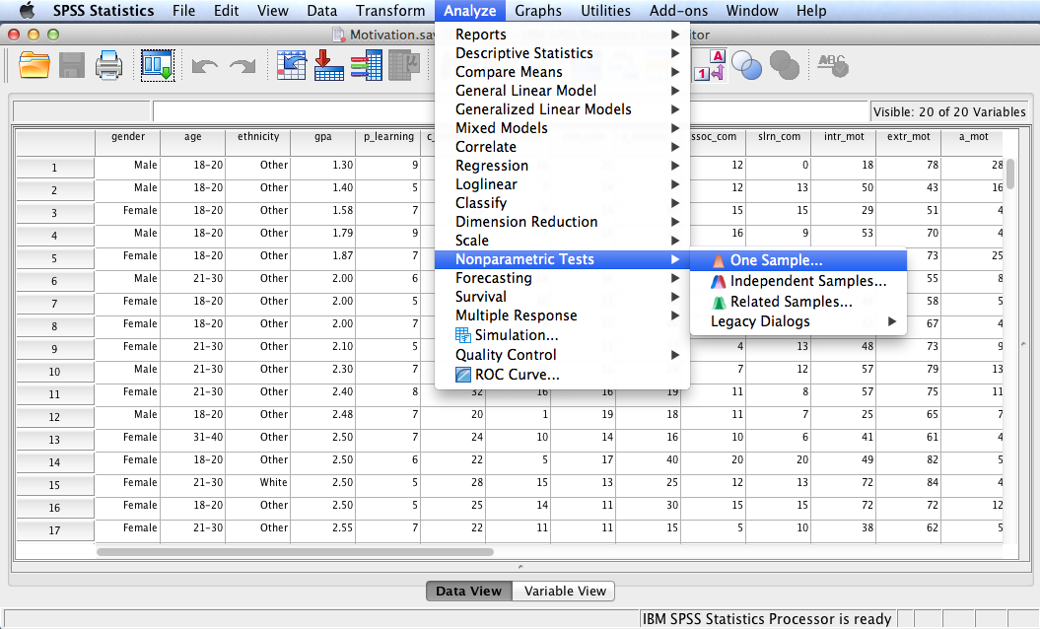
Follow the menu as indicated. A second method, using Legacy Dialogs, can also be used.

Slide 5
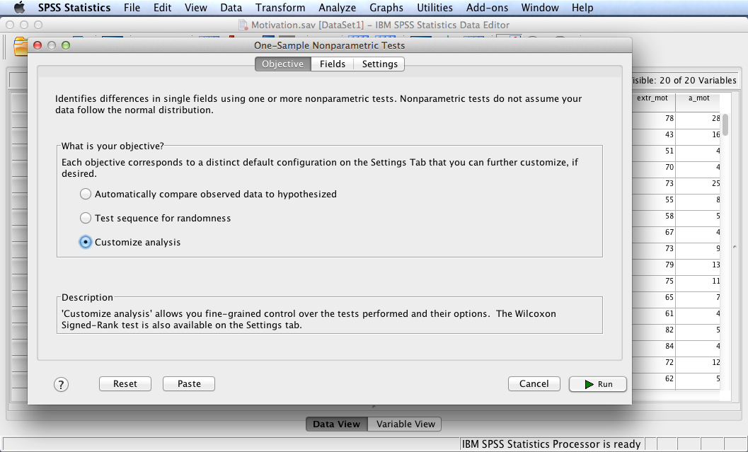
Select Customize analysis then click the Fields tab.

Slide 6
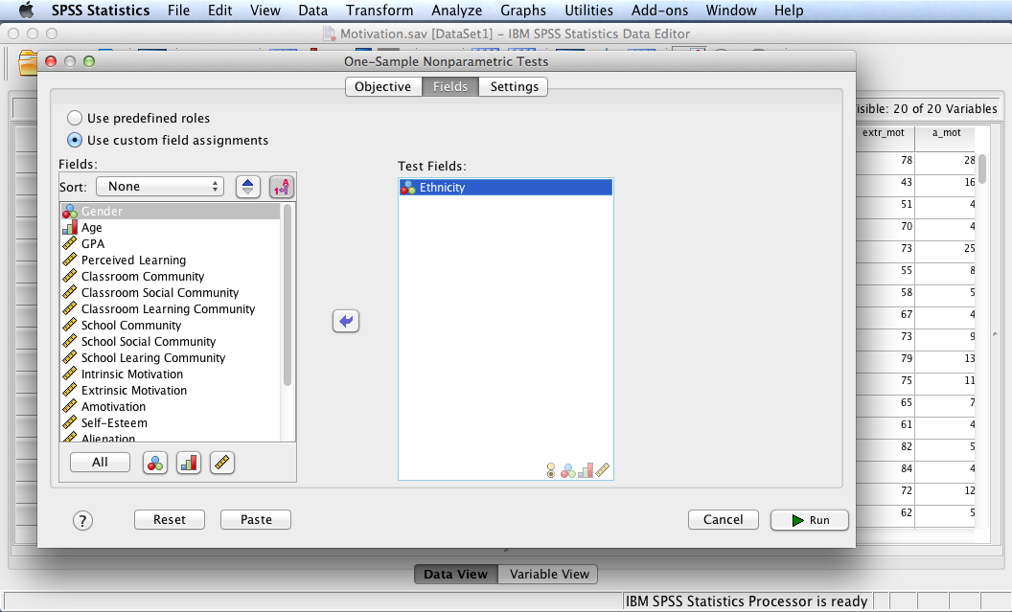
In this example, we will test the following null hypothesis:
H₀: There is no difference in the ethnicity of online college students (i.e., categories are equal).
Move variables so that only Ethnicity is in the Test Fields: box.
Click the Settings tab.

Slide 7
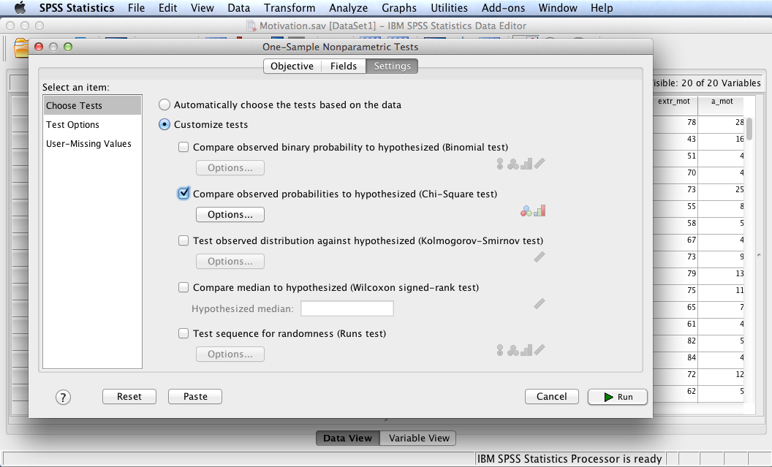
Check Customize tests and Compare observed probabilities to hypothesized (Chi-Square test).
Click Options.

Slide 8
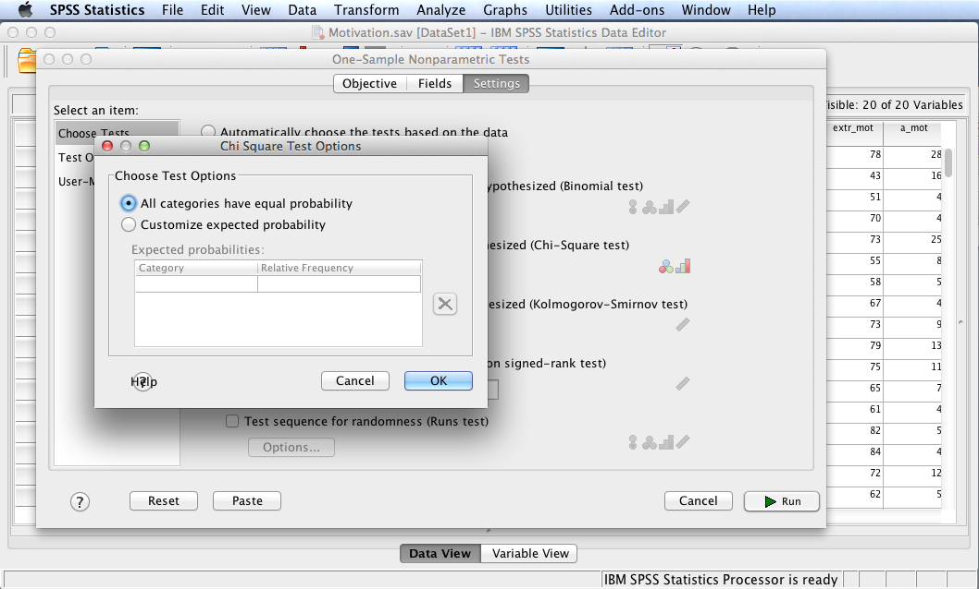
Choose All categories have equal probability.
Click OK.

Slide 9
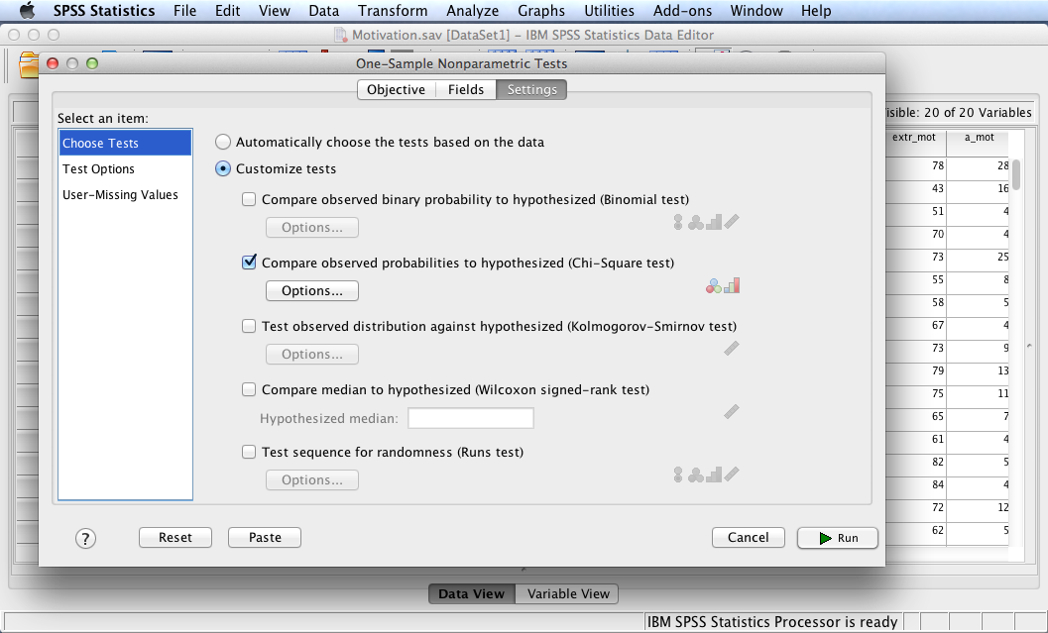
Select Test Options.

Slide 10
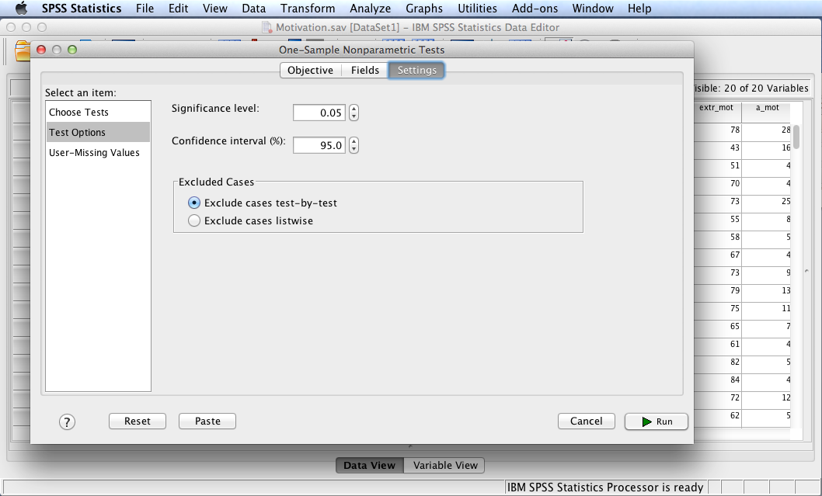
Note defaults. Click Run.

Slide 11
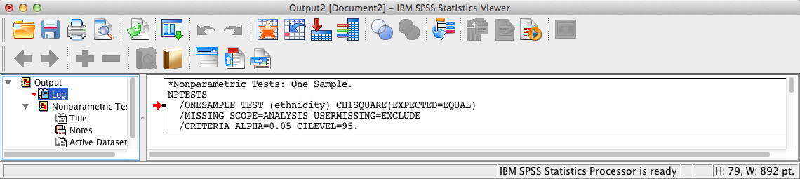
SPSS Output
The contents of the SPSS Log is the first output entry. The Log reflects the syntax used by SPSS to generate the Nonparametric Tests output.

Slide 12
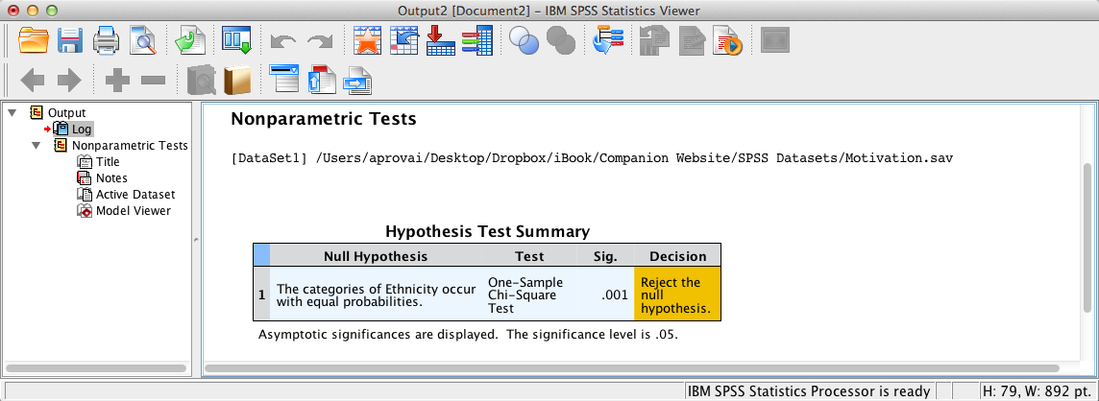
SPSS Output
The above summary table shows that the nonparametric test is significant since the significance level <= .05 (the assumed à priori significance level). Double-click the table in the SPSS output window to launch the Model Viewer.

Slide 13
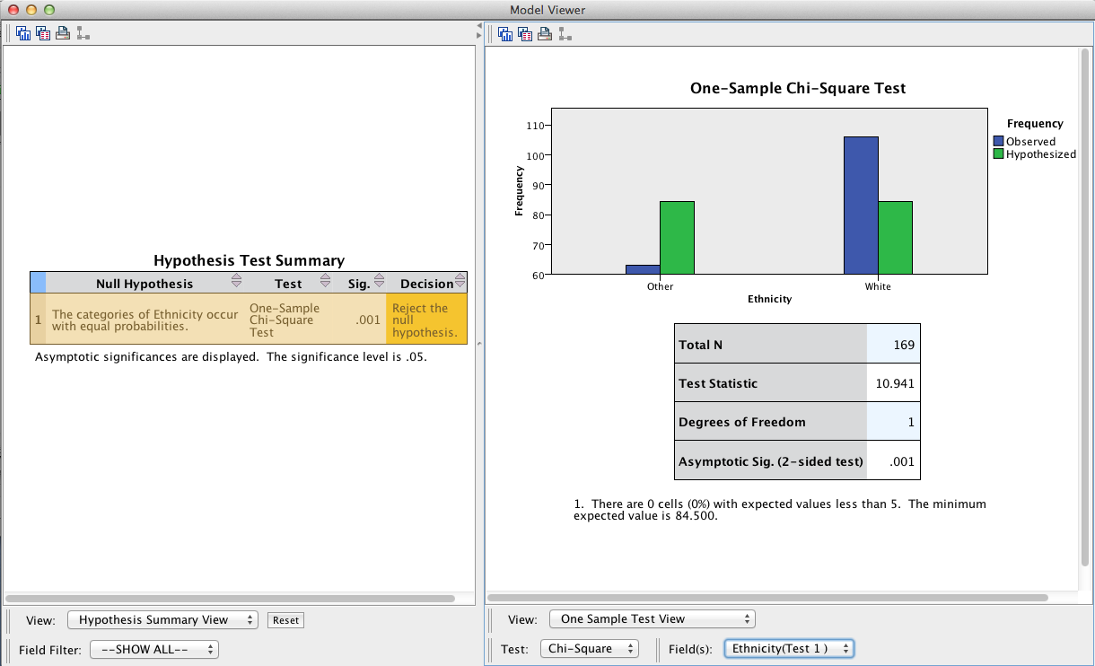
SPSS Output
The Model Viewer displays statistical details using the One-Sample Test View. Select Categorical Field Information from the View: pop-up menu to view a simple bar chart.

Slide 14
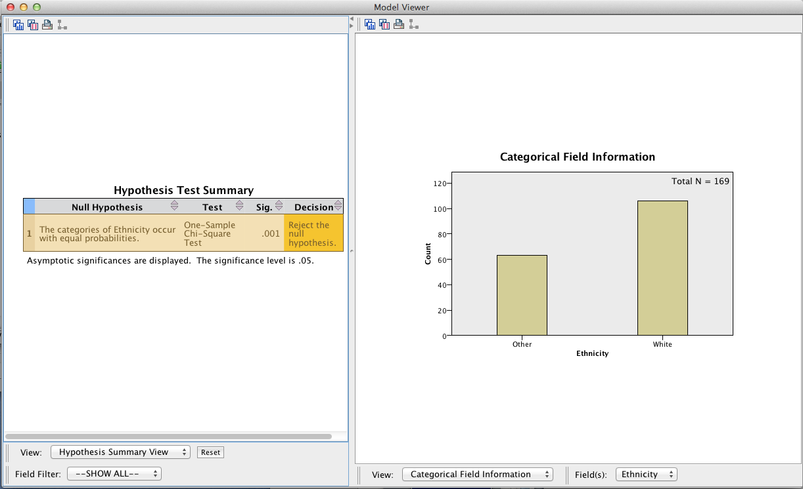
SPSS Output

Slide 15
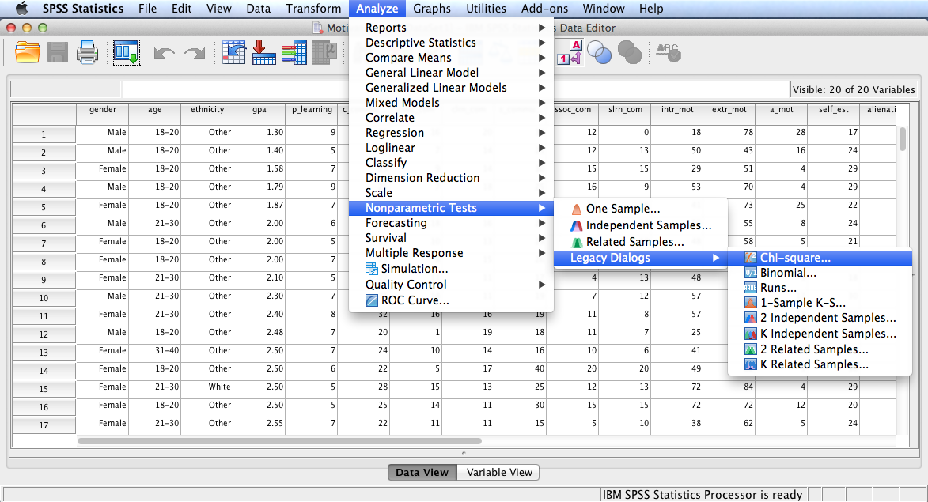
Follow the menu as indicated to run the same test using Legacy Dialogs.

Slide 16
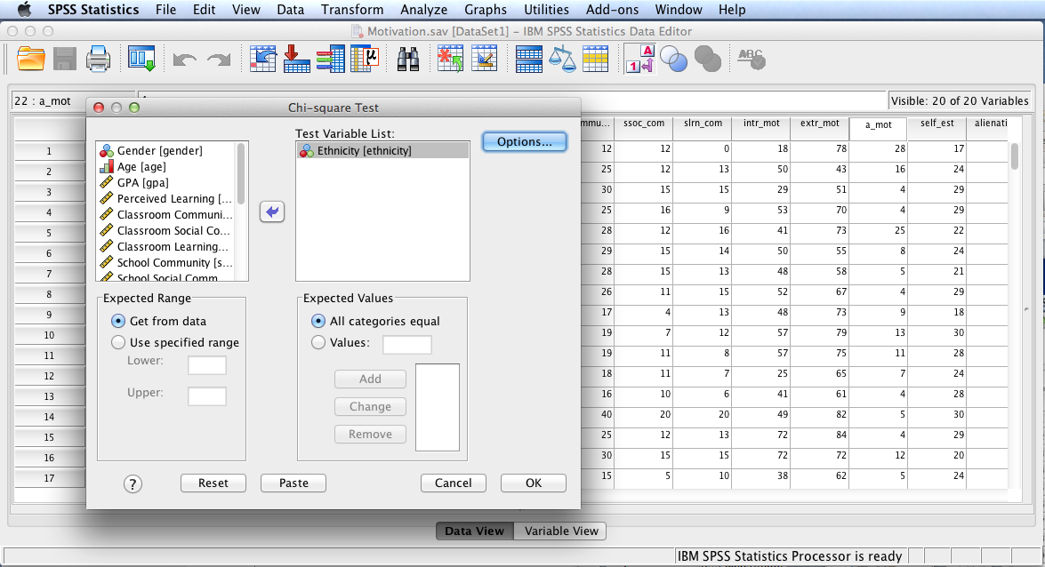
Move Ethnicity to the Test Variable List: box. Note the All categories equal option (default) is selected for Expected Values. Click Options.

Slide 17
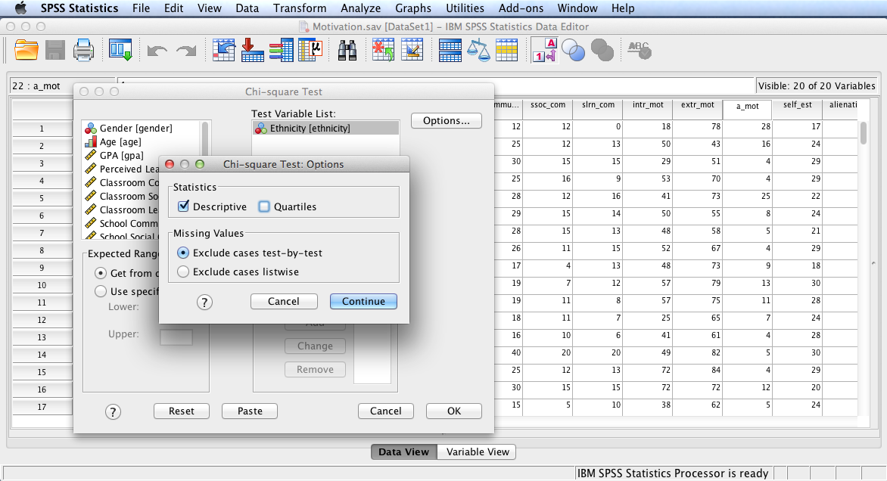
Check Descriptive to generate descriptive statistics. Click Continue and then OK.

Slide 18
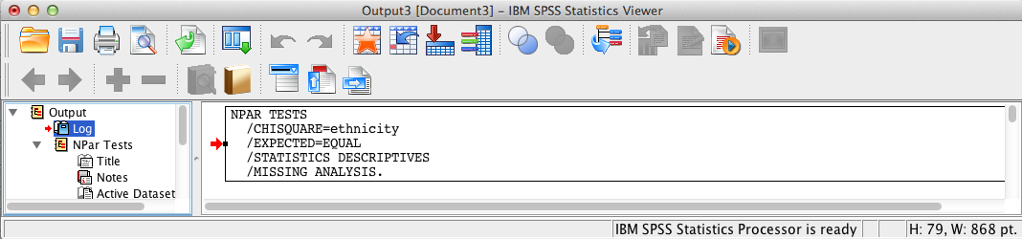
SPSS Output
The contents of the SPSS Log is the first output entry. The Log reflects the syntax used by SPSS to generate the NPar Tests output.

Slide 19
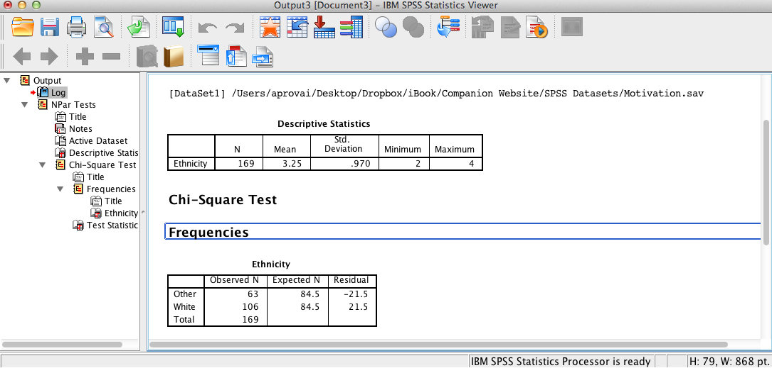
SPSS Output
Descriptive statistics to include frequencies are displayed. Note the difference between Observed N and Expected N for each category of ethnicity.

Slide 20
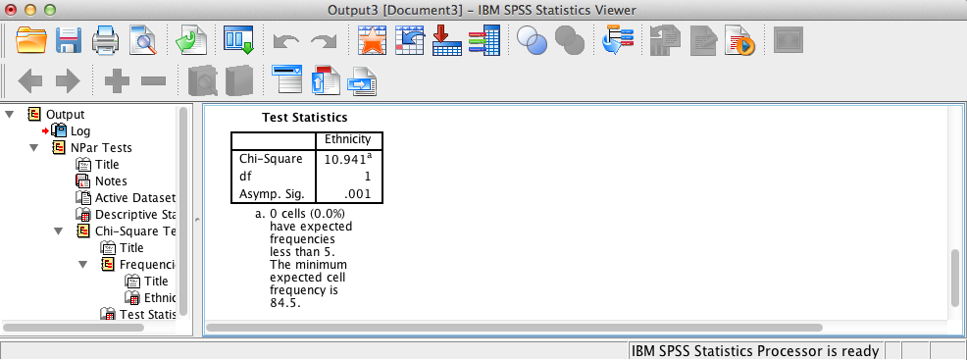
SPSS Output
The above SPSS output shows that the test is significant since the significance level <= .05 (the assumed à priori significance level). The footnote informs us that there are no expected frequencies less than a count of 5, which means that we have not violated this assumption of the chi-square goodness-of-fit test.
Npar test results and Nonparametric test results (previously run) are the same (as expected). Effect size is calculated using the following formula: effect size = , χ²/N(Categories – 1) = 10.941/ 169*1 = .06.

Slide 21
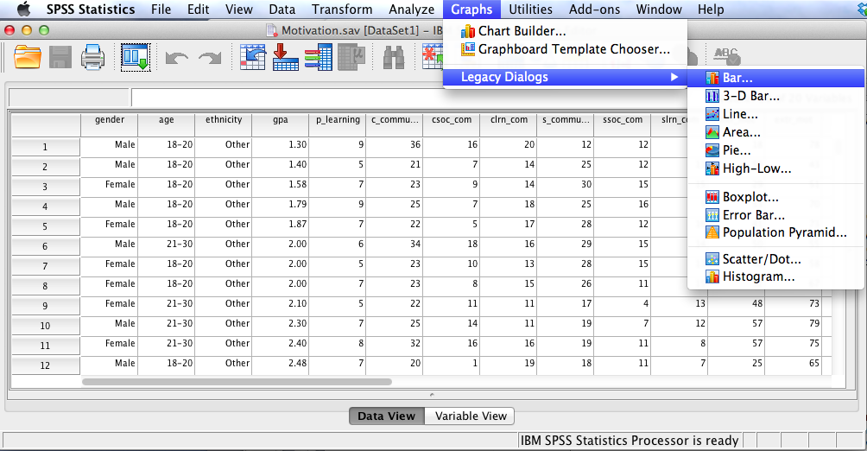
Follow the menu as indicated to create a bar chart that can be used as a figure in any research report. Alternatively, one can select Chart Builder.

Slide 22
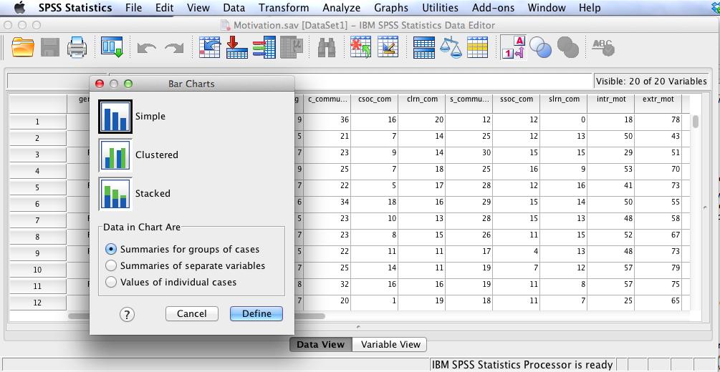
Select Simple and Summaries for groups of cases. Click Define.

Slide 23
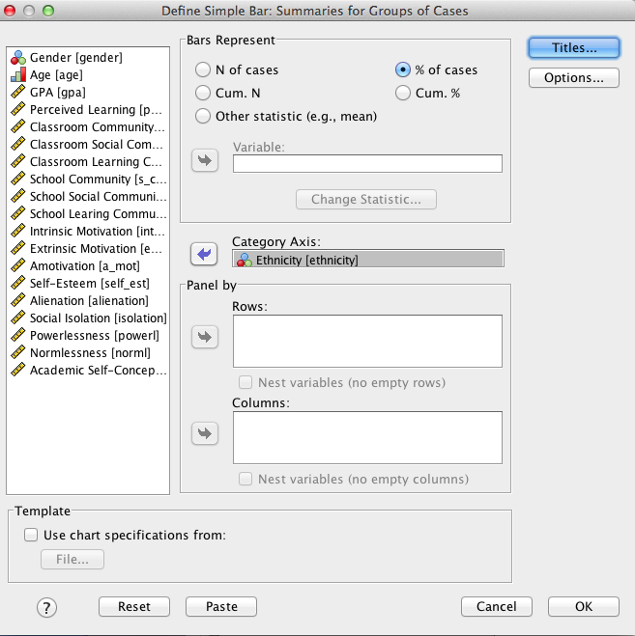
Select % of cases (alternatively select N of cases). Enter Ethnicity in the Catergory Axis: box. Click OK.

Slide 24
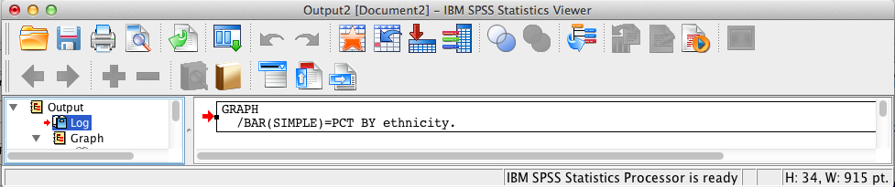
SPSS Output
The contents of the SPSS Log is the first output entry. The Log reflects the syntax used by SPSS to generate the Graph output.

Slide 25
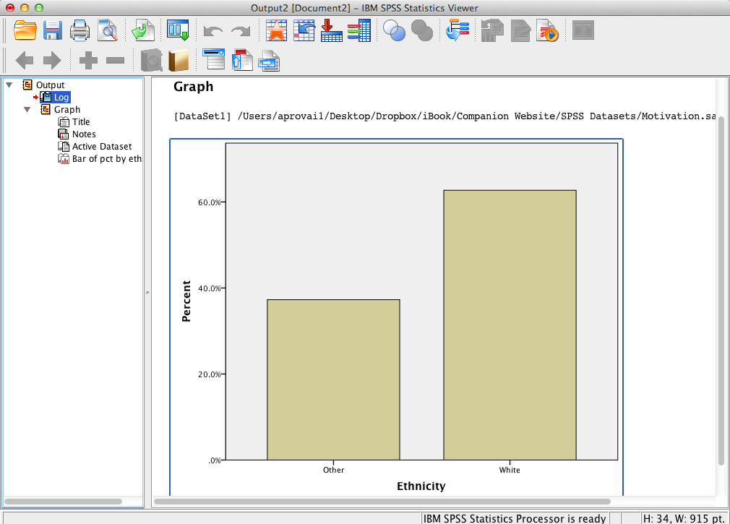
SPSS Output
SPSS generates the requested bar chart. Note Percent is the Y-axis. If N of cases had been requested in the Define dialog, the Y-axis would be Count.

Slide 26
Chi-Square Goodness-of-Fit Test Results Summary
H₀: There is no difference in the ethnicity of online college students (i.e., categories are equal). The test shows a statistically significant difference in the ethnicity of online college students, χ²(1, N = 169) = 10.94, p = .001. Consequently, there is evidence to reject the null hypothesis. Effect size = .06.

Slide 27
End of Presentation

